Slide 1




Predicting Crypto Assets Liquidity in Real-Time with Causal AI
www.causaLens.com
info@causaLens.com

Slide 2
Added Value

Slide 3






Value Add - Automation
Equip yourself with an “army” of virtual PhD Quants
Automated Data Searching
Automated Data Preparation
Automated Causal Discovery
Automated Model Building & Evaluation
Optimisation of Business KPI e.g Trading Strategy
Automated Feedback Loop
Explainable Causal Insights
Full Control & Transparency of the discovery process & results

Slide 4

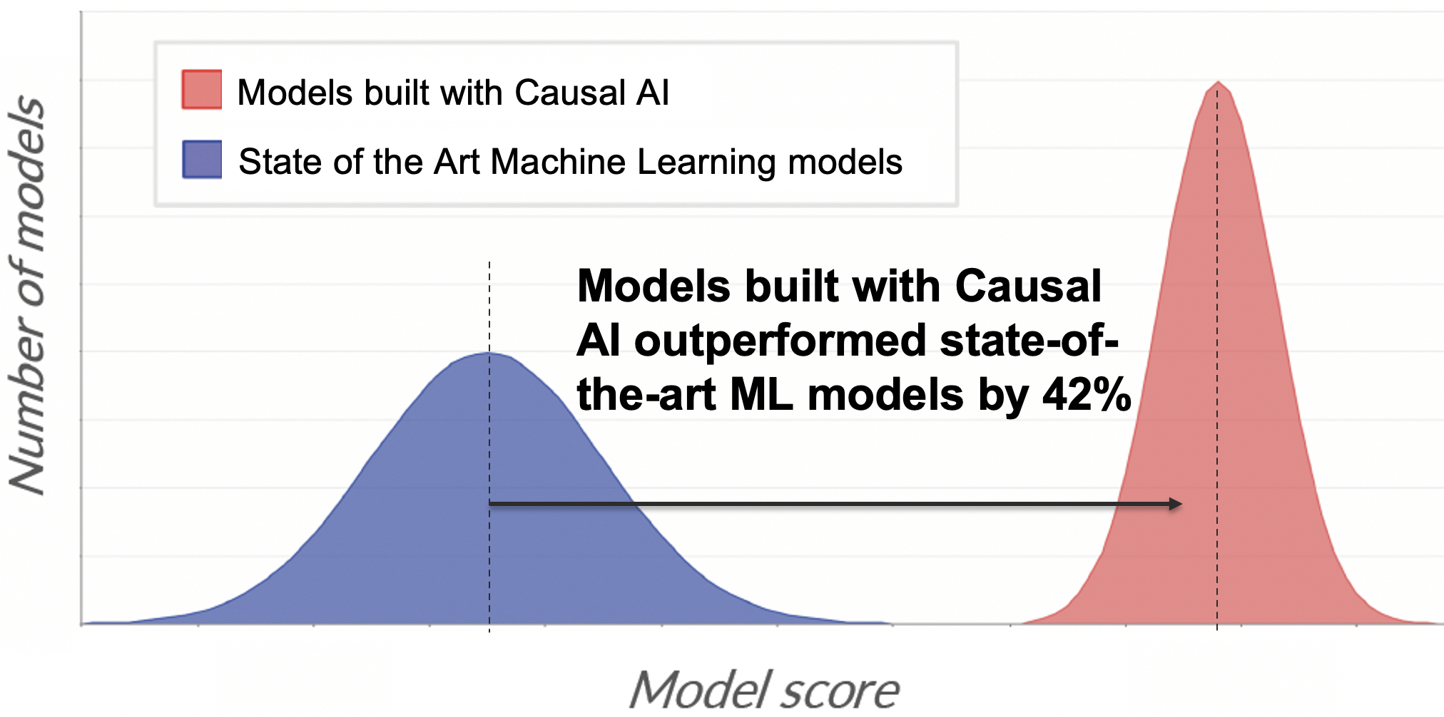
Value Add – Unique IP
Access the latest Technology & IP that is licensed by even the largest & most sophisticated systematic funds
Current Machine Learning Overfits
Current Approaches
✓
✘
Dynamic models
Static models
Causal drivers
✘
✓
Historical correlations
Explainable
Black box
✘
✓

Slide 5
Use Case Predicting Crypto Assets Liquidity in Real-Time with Causal AI

Slide 6
Data
Screenshot
Order book data
11 exchanges
32 instruments
Price, open, high, low, close & volume Information for 16 levels on bid and ask
1-minute frequency
30-day history

Slide 7
Insights
X% Directional Accuracy Achieved within Y hours
Autonomously Identified Z and P as predictive indicators
Screenshot Signal Testing + Backtest? (whatever looks good)
Autonomously evaluated X000s models
Autonomously evaluated & incorporated sentiment data

Slide 8
About us

Slide 9




Serving the most sophisticated institutions
Investment
Banking
Asset
Management
Market Making
and HFT
Hedge
Funds
Largest European Bank
Clients managing
$2 trillion
Two of the largest five global firms
Smallest client manages $20 billion
Models to predict order volumes and client activity
Causal drivers for a range of asset classes
Improved real-time market making
Predictive signals for all types of strategies
Impact
Improved execution performance & client services
Impact
More profitable trading strategies at the fraction of the cost
Impact
New signals, improved margins & protection against adversaries
Impact
Generation of outperformance across all strategies

Slide 10
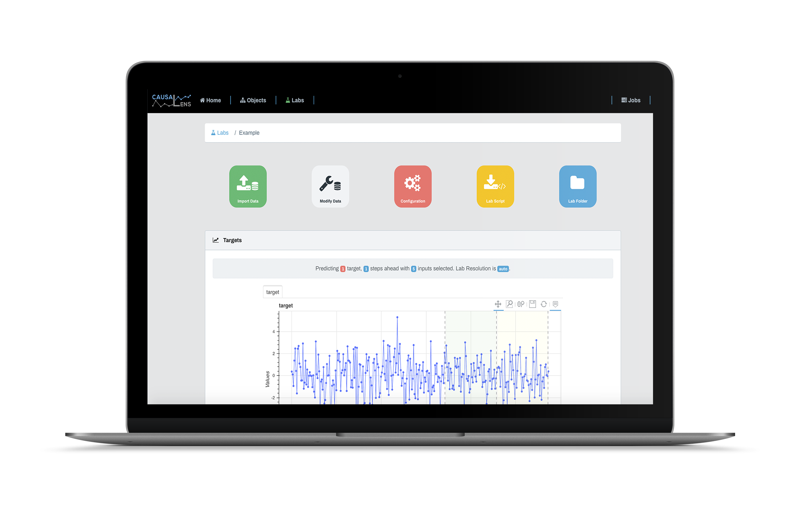
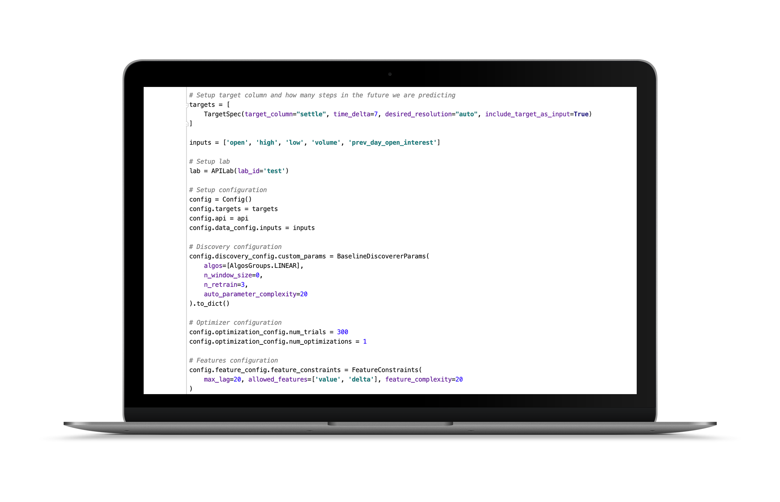
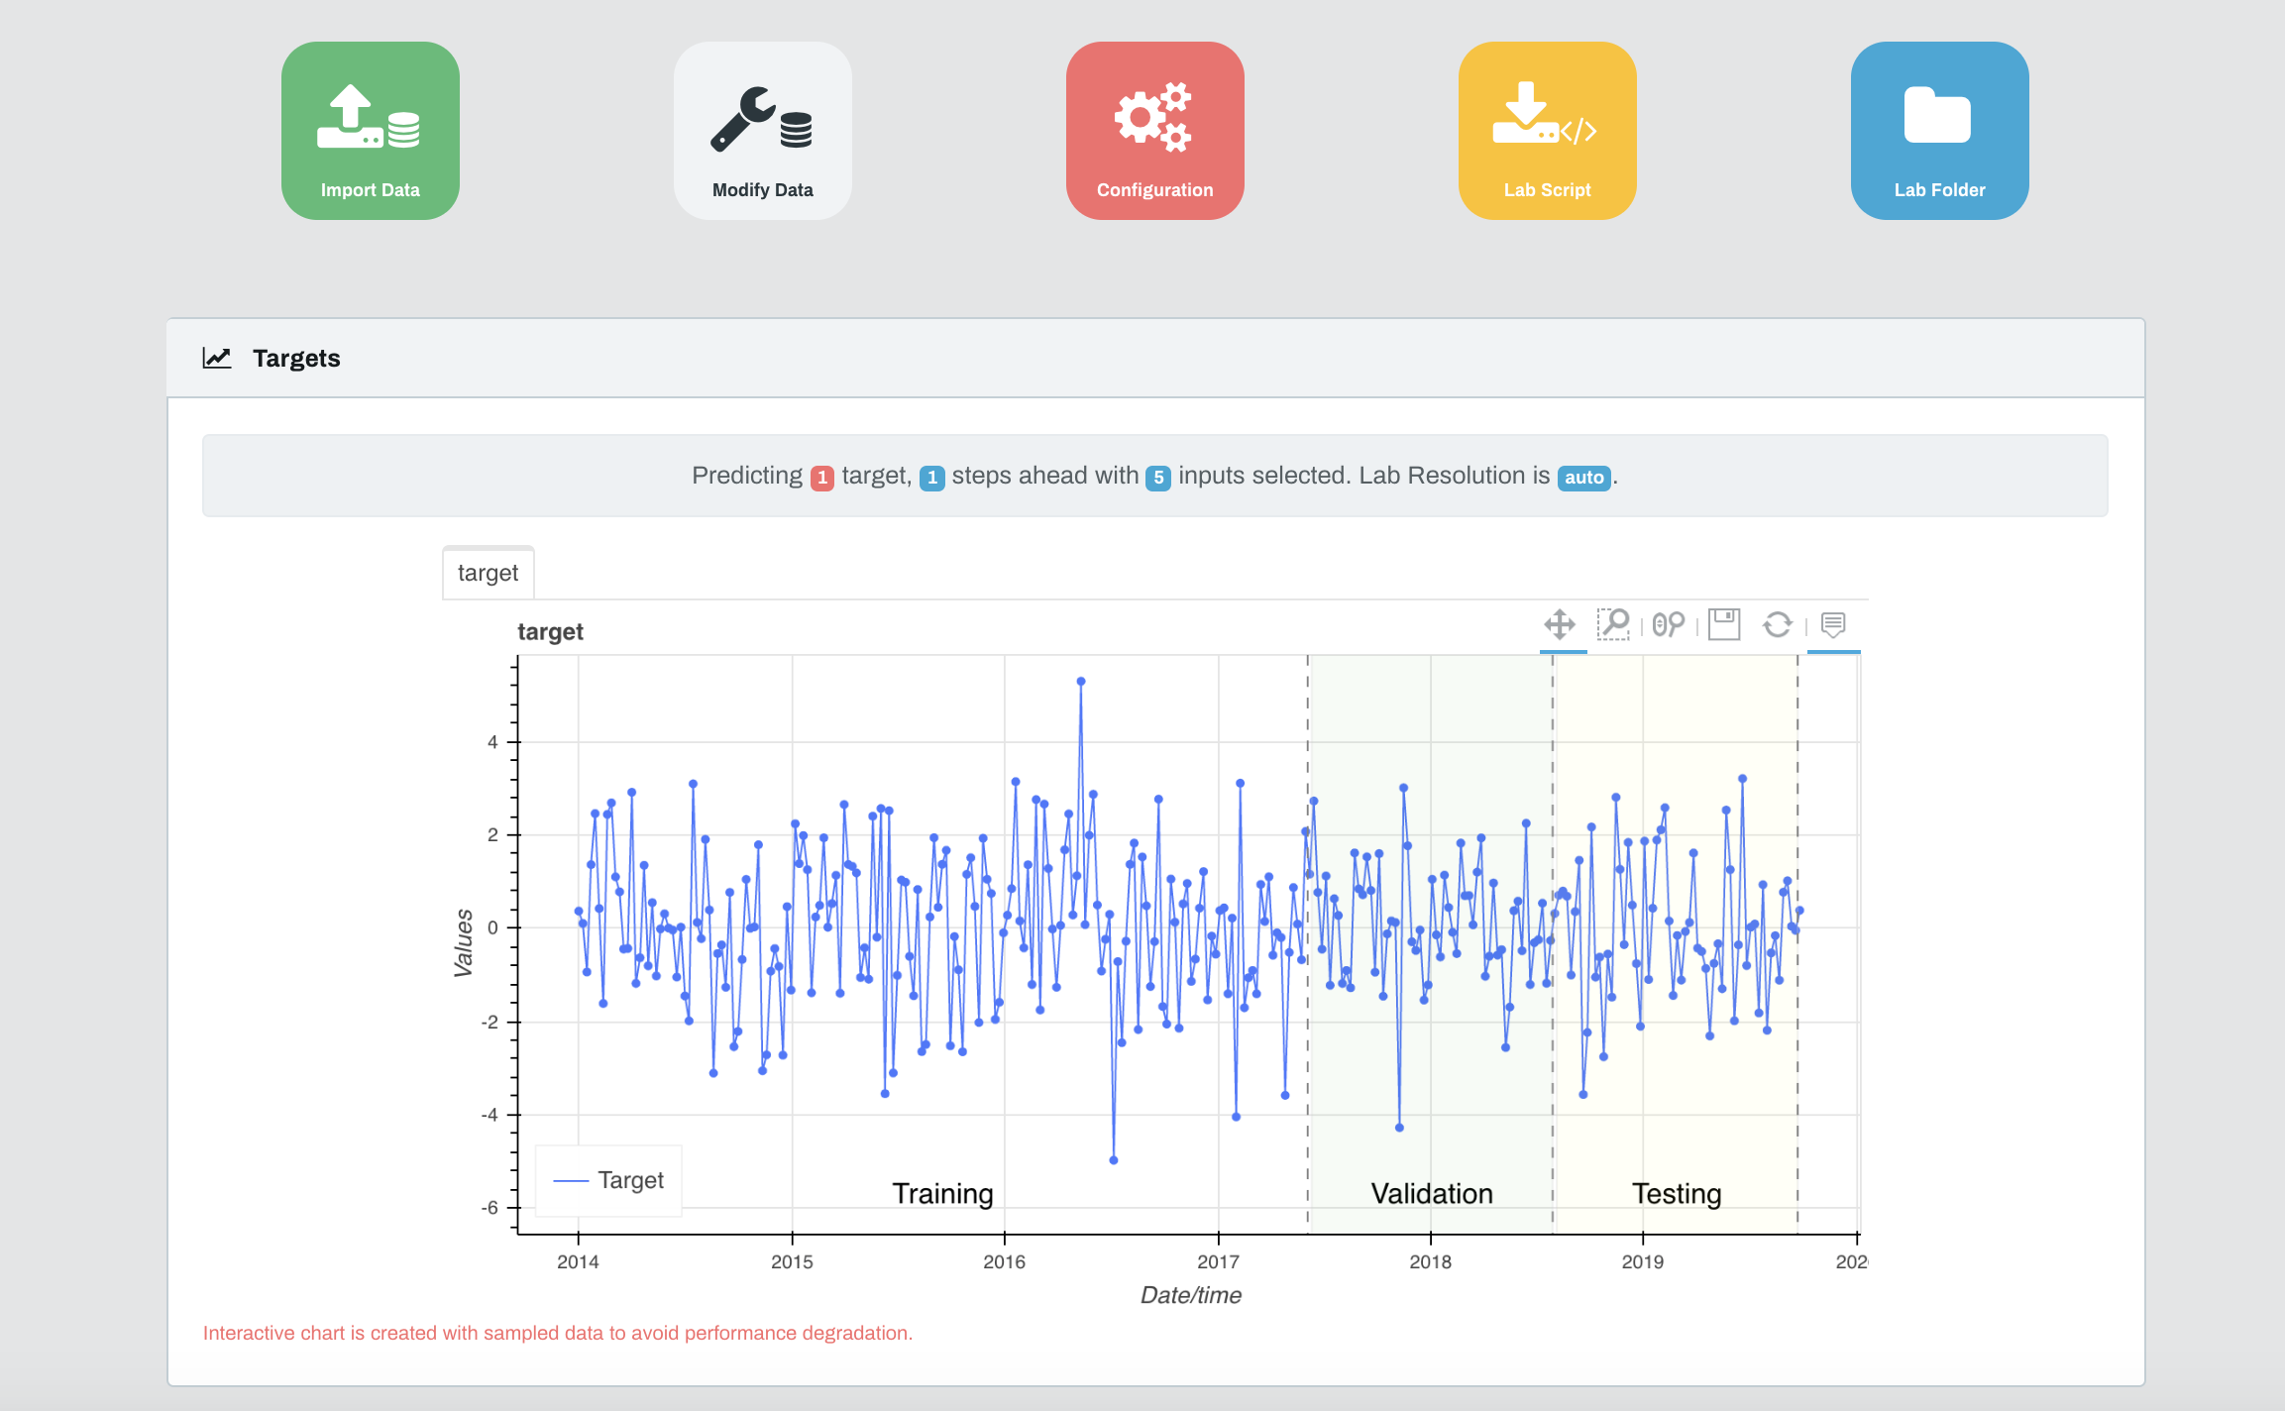
Empower Teams Throughout Your Business
User Interface - Intuitive and customisable
API - Powerful and easy to integrate
Empower Domain Experts
Empower Technology Teams

Slide 11
Seamless Integration in Your Workflows
1
Hour
96%
To proven value
on your problem
Pilot customer
conversion
Deployed Anywhere
Fully Managed Private Cloud
On-Prem
Library
Subprocess
Microservice via REST
On the Edge

Slide 12
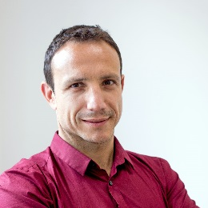

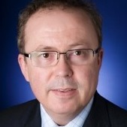

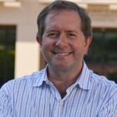




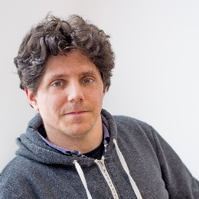
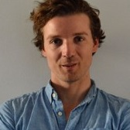







causaLens Attracts Top Scientists
Executive Team
Advisory Board
Dr. Darko Matovski, PhD
CEO
60%
50
Jose Marques, PhD
Ex-Head of Trading
Bridgewater
Top Hedge Funds in London
Part of teams managing $ billions
Of Current Team are PhDs
One of the Fastest Growing AI Companies
New PhD Hires
within 12 months
Commercialising AI research
(workplace of Alan Turing)
Mark Roomans, PhD
CEO Morningstar (EMEA)
PhD Machine Learning
Dr. Maksim Sipos, PhD
CTO
Best Investment in Deeptech Award [Link]
Machine Learning Companies to watch in Europe [Link]
Theo Mollinger
Senior Director Moody’s
Top Hedge Funds in the US
Trading strategies & peta-size systems
Institutional Investors
Software Engineering at CTO level
PhD Physics
100 most disruptive companies [Link]
Virtual Data Scientists and the War for talent [Link]

